Slide 1

DATABASE MANAGEMENT SYSTEMS
CS 623
Lion Social
Exploring the OLTP to OLAP pipeline

Slide 2
AGENDA
CS 623
Introduction and Overview
Architecture and Planning
Implementation Details
Project Premise
Core Use-Cases
Domain Requirements
Entities and Relationships
Data Flow
Schema Overview
Technical Considerations
Implementation Overview
System Evaluation

Slide 3
PREMISE AND OVERVIEW
CS 623
Our team was tasked with producing a working schema and data environment for a social media platform. Our architecture needed to balance the need for quick and clean write operations with a complex relational requirements. Particular focus was paid to reducing the number and frequency of queries via strategic, non-critical data redundancies.
Our overall architecture attempts to utilize the data flow model presented to us over the course of the semester: taking input into highly normalized tables and using ETL functionality to propagate data into query optimized data structures for consumption by users.
Please note that UI/UX concerns do not fall within scope for this project, and we have defaulted to assuming a best case scenario when considering application layer functionality.
DOMAIN REQUIREMENTS
TECHNICAL
CONSTRAINTS
DATA
FLOW

Slide 4

DOMAIN REQUIREMENTS
EXAMPLE.COM
1. User Profiles
The schema must be capable of capturing descriptive data about a given user. Eg: age, email, and name.
2. Content Generation
All content on the platform is user generated, for sake of simplicity we have opted for text-only content.
3. Platform Interactions
Users may interact with posts, message other users, or upload content to the platform.

Slide 5
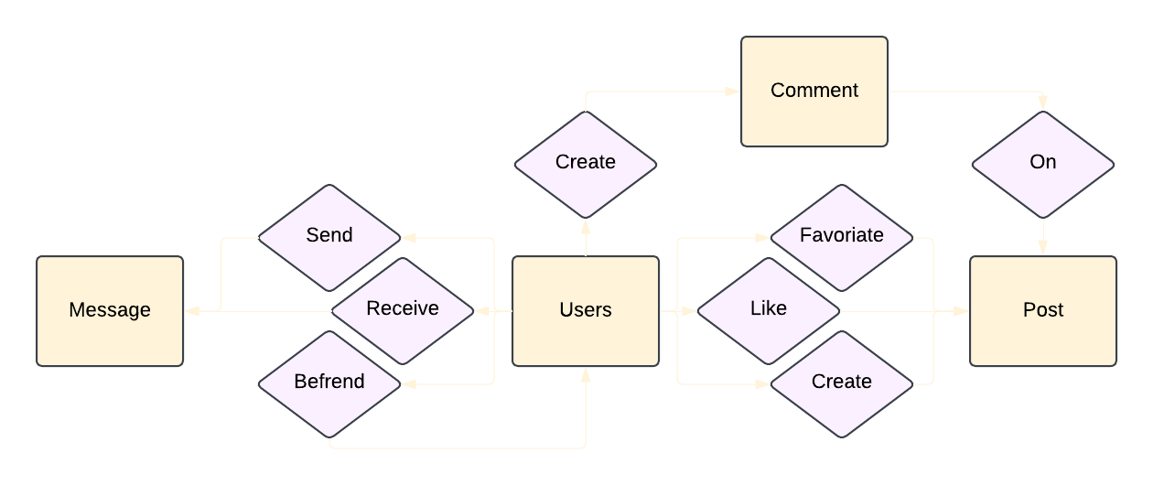
ENTITY RELATIONSHIP MODEL
CS 623
Users are the central pillar of any social platform, they initiate every interaction and generate all viewable content. We can see this pattern in real world examples when social platforms utilize synthetic user accounts for administrative purposes (eg: Reddit Bots, or Tom from MySpace).

Slide 6
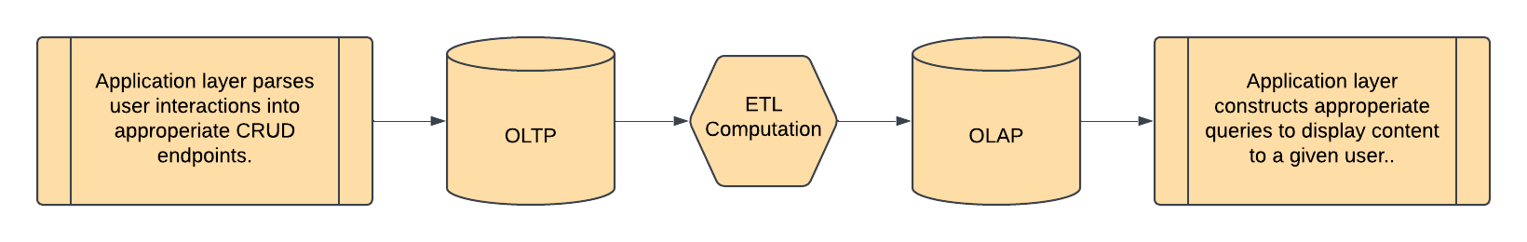
DATA FLOW
CS 637
Social media platforms like Facebook, Youtube, and TicToc have a persistent influx of user generated content. To accommodate this high throughput, data enters into the system via OLTP tables before being ingested via ETL logic into OLAP tables which are used to drive the content users see on the platform.

Slide 7
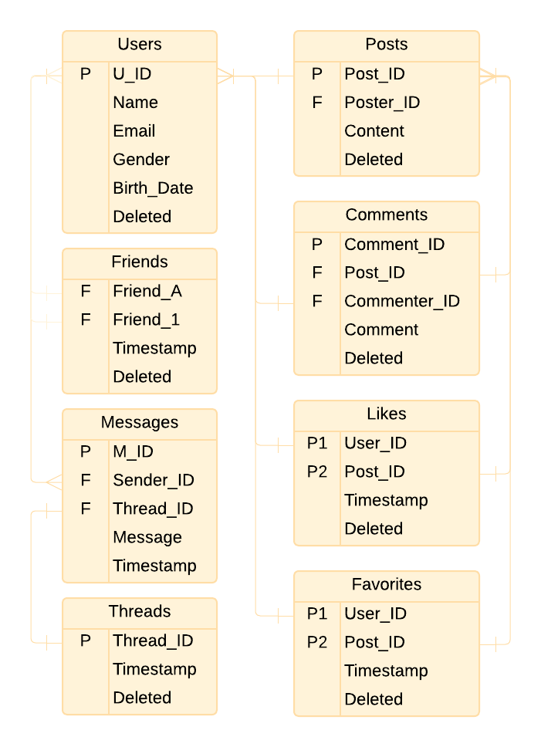
OLTP SCHEMA OVERVIEW
CS 623
The OLTP tables are highly normalized to facilitate data entry into the platform, reaching the 5th Normal Form.
Friends, Likes, and Favorites are all weak entities relying on composite keys for unique identification. This facilitates the tables purpose of expressing unique relationships between strong entities.

Slide 8
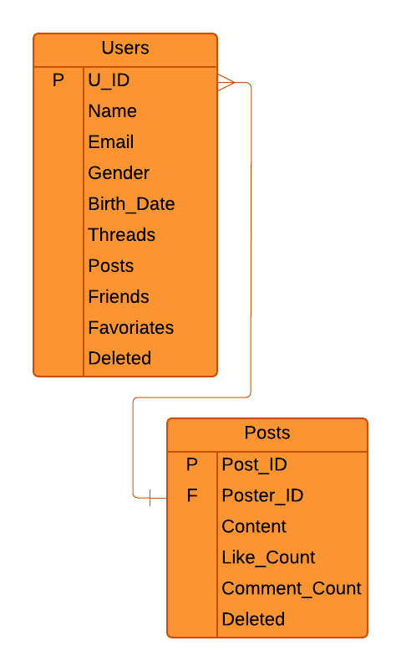
OLAP SCHEMA OVERVIEW
CS 623
While the OLTP Schema prioritizes data write operations, OLAP data stores prioritize read operations. As such our schema fails to reach the first form, but data which is redundantly represented presents a low risk for causing a fault in the system.
Please note that these tables replace their OLTP counterparts when generating an RDD, and are published with the Friends, Comments, Messages, and Likes tables.

Slide 9
IMPLEMENTATION OVERVIEW
CS 623
Initialize OLTP schema within Databricks
Query OLTP tables and export data
Initiate PySpark Environments for ETL
From our original MySQL schema, we adjusted our syntax and data entries to the DataBricks constraints before making our basic queries and entering our data.
We queried our DataBricks schema for individual tables, converted them to .csv files and uploaded them to DataBricks DBFS for conversion.
We created RDDs and Dataframes from our individual tables, and initiated structured queries using PySpark that allowed us to pull data from the RDDs and store them as DataFrames.

Slide 10

TECHNICAL CONSIDERATIONS
CS 623
1. DataBrick’s syntax
2. DataBrick’s CE Edition
DataBricks SQL syntax supports a smaller set of data types than MySQL and does not support constraints.
Using DataBricks free distribution came with some technical limitations.

Slide 11


SYSTEM EVALUATION
CS 623
Data Creation
Data Retrieval
Programmatic Complexity
5/5
4/5
4/5
Domain Requirements
Project Rubric
5/5
5/5

Slide 12
Questions
Comments
Concerns
CONCLUSION
CS 623

